Slide 1

Chapter 18
Searching and Sorting

Slide 2
Chapter Scope
Linear search and binary search algorithms
Several sorting algorithms, including:
selection sort
insertion sort
bubble sort
quick sort
merge sort
Complexity of the search and sort algorithms
Comparators

Slide 3
Searching
Searching is the process of finding a target element among a group of items (the search pool), or determining that it isn't there
This requires repetitively comparing the target to candidates in the search pool
An efficient search performs no more comparisons than it has to

Slide 4
Searching
We'll define the algorithms such that they can search any set of objects, therefore we will search objects that implement the Comparable interface
Recall that the compareTo method returns an integer that specifies the relationship between two objects:
obj1.compareTo(obj2)
This call returns a number less than, equal to, or greater than 0 if obj1 is less than, equal to, or greater than obj2, respectively

Slide 5
Generic Methods
A class that works on a generic type must be instantiated
Since our methods will be static, we'll define each method to be a generic method
A generic method header contains the generic type before the return type of the method:
public static <T extends Comparable<T>> boolean
linearSearch(T[] data, int min, int max, T target)

Slide 6
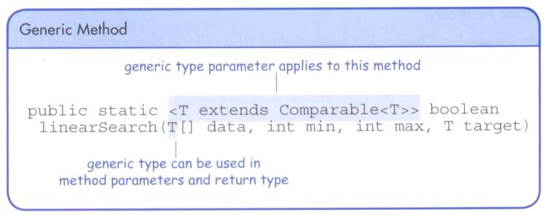
Generic Methods
The generic type can be used in the return type, the parameter list, and the method body

Slide 7
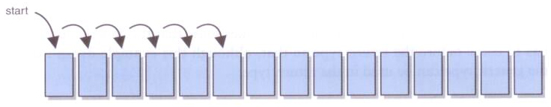
Linear Search
A linear search simply examines each item in the search pool, one at a time, until either the target is found or until the pool is exhausted
This approach does not assume the items in the search pool are in any particular order

Slide 8
/**
* Searches the specified array of objects using a linear search
* algorithm.
*
* @param data the array to be searched
* @param min the integer representation of the minimum value
* @param max the integer representation of the maximum value
* @param target the element being searched for
* @return true if the desired element is found
*/
public static <T>
boolean linearSearch(T[] data, int min, int max, T target)
{
int index = min;
boolean found = false;
while (!found && index <= max)
{
found = data[index].equals(target);
index++;
}
return found;
}

Slide 9
Binary Search
If the search pool is sorted, then we can be more efficient than a linear search
A binary search eliminates large parts of the search pool with each comparison
Instead of starting the search at one end, we begin in the middle
If the target isn't found, we know that if it is in the pool at all, it is in one half or the other
We can then jump to the middle of that half, and continue similarly

Slide 10
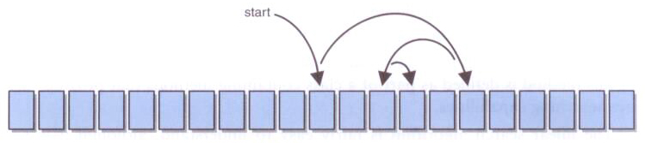
Binary Search
Each comparison in a binary search eliminates half of the viable candidates that remain in the search pool:

Slide 11
Binary Search
For example, find the number 29 in the following sorted list of numbers:
8 15 22 29 36 54 55 61 70 73 88
First, compare the target to the middle value 54
We now know that if 29 is in the list, it is in the front half of the list
With one comparison, we’ve eliminated half of the data
Then compare to 22, eliminating another quarter of the data, etc.

Slide 12
Binary Search
A binary search algorithm is often implemented recursively
Each recursive call searches a smaller portion of the search pool
The base case is when there are no more viable candidates
At any point there may be two “middle” values, in which case the first is used

Slide 13
/**
* Searches the specified array of objects using a binary search
* algorithm.
*
* @param data the array to be searched
* @param min the integer representation of the minimum value
* @param max the integer representation of the maximum value
* @param target the element being searched for
* @return true if the desired element is found
*/
public static <T extends Comparable<T>>
boolean binarySearch(T[] data, int min, int max, T target)
{
boolean found = false;
int midpoint = (min + max) / 2; // determine the midpoint
if (data[midpoint].compareTo(target) == 0)
found = true;
else if (data[midpoint].compareTo(target) > 0)
{
if (min <= midpoint - 1)
found = binarySearch(data, min, midpoint - 1, target);
}
else if (midpoint + 1 <= max)
found = binarySearch(data, midpoint + 1, max, target);
return found;
}

Slide 14
Comparing Search Algorithms
The expected case for finding an element with a linear search is n/2, which is O(n)
Worst case is also O(n)
The worst case for binary search is (log₂n) / 2 comparisons
Which makes binary search O(log n)
Keep in mind that for binary search to work, the elements must be already sorted

Slide 15
Sorting
Sorting is the process of arranging a group of items into a defined order based on particular criteria
Many sorting algorithms have been designed
Sequential sorts require approximately n² comparisons to sort n elements
Logarithmic sorts typically require nlog₂n comparisons to sort n elements
Let's define a generic sorting problem that any of our sorting algorithms could help solve
As with searching, we must be able to compare one element to another

Slide 16
/**
* SortPhoneList driver for testing an object selection sort.
*
* @author Java Foundations
* @version 4.0
*/
public class SortPhoneList
{
/**
* Creates an array of Contact objects, sorts them, then prints
* them.
*/
public static void main(String[] args)
{
Contact[] friends = new Contact[7];
friends[0] = new Contact("John", "Smith", "610-555-7384");
friends[1] = new Contact("Sarah", "Barnes", "215-555-3827");
friends[2] = new Contact("Mark", "Riley", "733-555-2969");
friends[3] = new Contact("Laura", "Getz", "663-555-3984");
friends[4] = new Contact("Larry", "Smith", "464-555-3489");
friends[5] = new Contact("Frank", "Phelps", "322-555-2284");
friends[6] = new Contact("Marsha", "Grant", "243-555-2837");
Sorting.insertionSort(friends);
for (Contact friend : friends)
System.out.println(friend);
}
}

Slide 17
/**
* Contact represents a phone contact.
*
* @author Java Foundations
* @version 4.0
*/
public class Contact implements Comparable<Contact>
{
private String firstName, lastName, phone;
/**
* Sets up this contact with the specified information.
*
* @param first a string representation of a first name
* @param last a string representation of a last name
* @param telephone a string representation of a phone number
*/
public Contact(String first, String last, String telephone)
{
firstName = first;
lastName = last;
phone = telephone;
}

Slide 18
/**
* Returns a description of this contact as a string.
*
* @return a string representation of this contact
*/
public String toString()
{
return lastName + ", " + firstName + "\t" + phone;
}
/**
* Uses both last and first names to determine lexical ordering.
*
* @param other the contact to be compared to this contact
* @return the integer result of the comparison
*/
public int compareTo(Contact other)
{
int result;
if (lastName.equals(other.lastName))
result = firstName.compareTo(other.firstName);
else
result = lastName.compareTo(other.lastName);
return result;
}
}

Slide 19
Selection Sort
Selection sort orders a list of values by repetitively putting a particular value into its final position
More specifically:
find the smallest value in the list
switch it with the value in the first position
find the next smallest value in the list
switch it with the value in the second position
repeat until all values are in their proper places

Slide 20
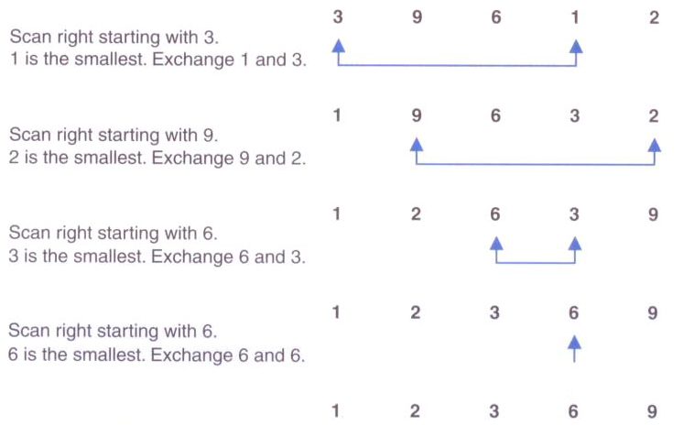
Selection Sort

Slide 21
/**
* Sorts the specified array of integers using the selection
* sort algorithm.
*
* @param data the array to be sorted
*/
public static <T extends Comparable<T>>
void selectionSort(T[] data)
{
int min;
T temp;
for (int index = 0; index < data.length-1; index++)
{
min = index;
for (int scan = index+1; scan < data.length; scan++)
if (data[scan].compareTo(data[min])<0)
min = scan;
swap(data, min, index);
}
}

Slide 22
/**
* Swaps to elements in an array. Used by various sorting algorithms.
*
* @param data the array in which the elements are swapped
* @param index1 the index of the first element to be swapped
* @param index2 the index of the second element to be swapped
*/
private static <T extends Comparable<T>>
void swap(T[] data, int index1, int index2)
{
T temp = data[index1];
data[index1] = data[index2];
data[index2] = temp;
}

Slide 23
Insertion Sort
Insertion sort orders a values by repetitively inserting a particular value into a sorted subset of the list
More specifically:
consider the first item to be a sorted sublist of length 1
insert the second item into the sorted sublist, shifting the first item if needed
insert the third item into the sorted sublist, shifting the other items as needed
repeat until all values have been inserted into their proper positions

Slide 24
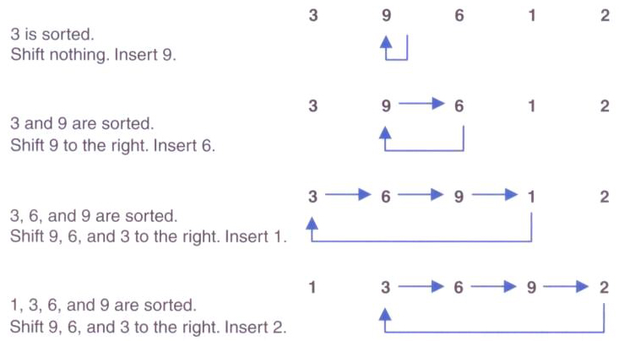
Insertion Sort

Slide 25
/**
* Sorts the specified array of objects using an insertion
* sort algorithm.
*
* @param data the array to be sorted
*/
public static <T extends Comparable<T>>
void insertionSort(T[] data)
{
for (int index = 1; index < data.length; index++)
{
T key = data[index];
int position = index;
// shift larger values to the right
while (position > 0 && data[position-1].compareTo(key) > 0)
{
data[position] = data[position-1];
position--;
}
data[position] = key;
}
}

Slide 26
Bubble Sort
Bubble sort orders a list of values by repetitively comparing neighboring elements and swapping their positions if necessary
More specifically:
scan the list, exchanging adjacent elements if they are not in relative order; this bubbles the highest value to the top
scan the list again, bubbling up the second highest value
repeat until all elements have been placed in their proper order

Slide 27
/**
* Sorts the specified array of objects using a bubble sort
* algorithm.
*
* @param data the array to be sorted
*/
public static <T extends Comparable<T>>
void bubbleSort(T[] data)
{
int position, scan;
T temp;
for (position = data.length - 1; position >= 0; position--)
{
for (scan = 0; scan <= position - 1; scan++)
{
if (data[scan].compareTo(data[scan+1]) > 0)
swap(data, scan, scan + 1);
}
}
}

Slide 28
Quick Sort
Quick sort orders values by partitioning the list around one element, then sorting each partition
More specifically:
choose one element in the list to be the partition element
organize the elements so that all elements less than the partition element are to the left and all greater are to the right
apply the quick sort algorithm (recursively) to both partitions

Slide 29
/**
* Sorts the specified array of objects using the quick sort algorithm.
*
* @param data the array to be sorted
*/
public static <T extends Comparable<T>>
void quickSort(T[] data)
{
quickSort(data, 0, data.length - 1);
}

Slide 30
/**
* Recursively sorts a range of objects in the specified array using the
* quick sort algorithm.
*
* @param data the array to be sorted
* @param min the minimum index in the range to be sorted
* @param max the maximum index in the range to be sorted
*/
private static <T extends Comparable<T>>
void quickSort(T[] data, int min, int max)
{
if (min < max)
{
// create partitions
int indexofpartition = partition(data, min, max);
// sort the left partition (lower values)
quickSort(data, min, indexofpartition - 1);
// sort the right partition (higher values)
quickSort(data, indexofpartition + 1, max);
}
}

Slide 31
/**
* Used by the quick sort algorithm to find the partition.
*
* @param data the array to be sorted
* @param min the minimum index in the range to be sorted
* @param max the maximum index in the range to be sorted
*/
private static <T extends Comparable<T>>
int partition(T[] data, int min, int max)
{
T partitionelement;
int left, right;
int middle = (min + max) / 2;
// use the middle data value as the partition element
partitionelement = data[middle];
// move it out of the way for now
swap(data, middle, min);
left = min;
right = max;

Slide 32
while (left < right)
{
// search for an element that is > the partition element
while (left < right && data[left].compareTo(partitionelement) <= 0)
left++;
// search for an element that is < the partition element
while (data[right].compareTo(partitionelement) > 0)
right--;
// swap the elements
if (left < right)
swap(data, left, right);
}
// move the partition element into place
swap(data, min, right);
return right;
}

Slide 33
Merge Sort
Merge sort orders values by recursively dividing the list in half until each sub-list has one element, then recombining
More specifically:
divide the list into two roughly equal parts
recursively divide each part in half, continuing until a part contains only one element
merge the two parts into one sorted list
continue to merge parts as the recursion unfolds

Slide 34
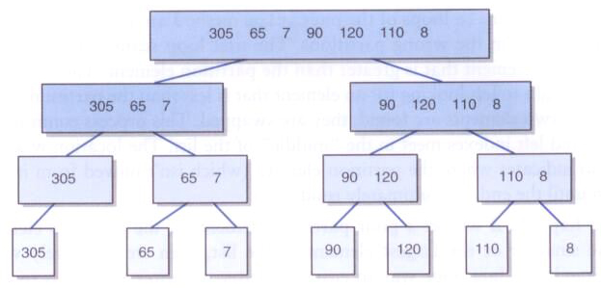
Merge Sort
Dividing lists in half repeatedly:

Slide 35
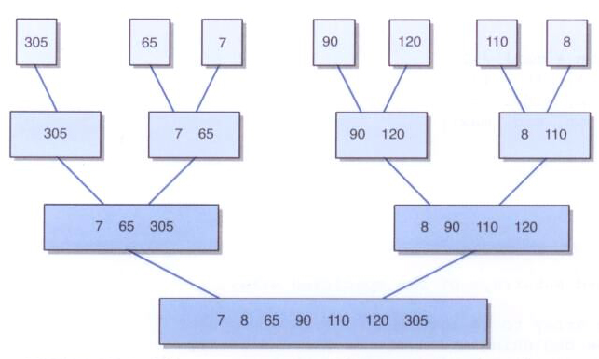
Merge Sort
Merging sorted elements

Slide 36
/**
* Sorts the specified array of objects using the merge sort
* algorithm.
*
* @param data the array to be sorted
*/
public static <T extends Comparable<T>>
void mergeSort(T[] data)
{
mergeSort(data, 0, data.length - 1);
}
/**
* Recursively sorts a range of objects in the specified array using the
* merge sort algorithm.
*
* @param data the array to be sorted
* @param min the index of the first element
* @param max the index of the last element
*/
private static <T extends Comparable<T>>
void mergeSort(T[] data, int min, int max)
{
if (min < max)
{
int mid = (min + max) / 2;
mergeSort(data, min, mid);
mergeSort(data, mid+1, max);
merge(data, min, mid, max);
}
}

Slide 37
/**
* Merges two sorted subarrays of the specified array.
*
* @param data the array to be sorted
* @param first the beginning index of the first subarray
* @param mid the ending index fo the first subarray
* @param last the ending index of the second subarray
*/
@SuppressWarnings("unchecked")
private static <T extends Comparable<T>>
void merge(T[] data, int first, int mid, int last)
{
T[] temp = (T[])(new Comparable[data.length]);
int first1 = first, last1 = mid; // endpoints of first subarray
int first2 = mid+1, last2 = last; // endpoints of second subarray
int index = first1; // next index open in temp array
// Copy smaller item from each subarray into temp until one
// of the subarrays is exhausted
while (first1 <= last1 && first2 <= last2)
{
if (data[first1].compareTo(data[first2]) < 0)
{
temp[index] = data[first1];
first1++;
}

Slide 38
else
{
temp[index] = data[first2];
first2++;
}
index++;
}
// Copy remaining elements from first subarray, if any
while (first1 <= last1)
{
temp[index] = data[first1];
first1++;
index++;
}
// Copy remaining elements from second subarray, if any
while (first2 <= last2)
{
temp[index] = data[first2];
first2++;
index++;
}
// Copy merged data into original array
for (index = first; index <= last; index++)
data[index] = temp[index];
}

Slide 39
Comparing Sorts
Selection sort, insertion sort, and bubble sort use different techniques, but are all O(n²)
They are all based in a nested loop approach
In quick sort, if the partition element divides the elements in half, each recursive call operates on about half the data
The act of partitioning the elements at each level is O(n)
The effort to sort the entire list is O(n log n)
It could deteriorate to O(n²) if the partition element is poorly chosen

Slide 40
Comparing Sorts
Merge sort divides the list repeatedly in half, which results in the O(log n) portion
The act of merging is O(n)
So the efficiency of merge sort is O(n log n)
Selection, insertion, and bubble sorts are called quadratic sorts
Quick sort and merge sort are called logarithmic sorts

Slide 41
Radix Sort
Let's look at one other sorting algorithm, which only works when a sort key can be defined
Separate queues are used to store elements based on the structure of the sort key
For example, to sort decimal numbers, we'd use ten queues, one for each possible digit (0 – 9)
To keep our example simpler, we'll restrict our values to the digits 0 - 5

Slide 42
Radix Sort
The radix sort makes three passes through the data, for each position of our 3-digit numbers
A value is put on the queue corresponding to that position's digit
Once all three passes are finished, the data is sorted in each queue

Slide 43
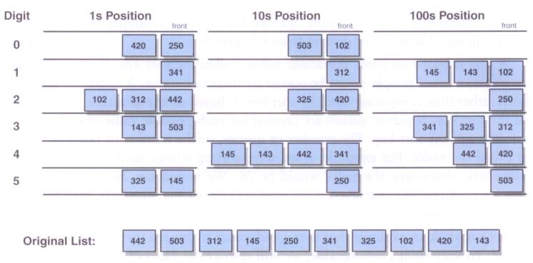
Radix Sort
An example using six queues to sort 10 three-digit numbers:

Slide 44
import java.util.*;
/**
* RadixSort driver demonstrates the use of queues in the execution of a radix sort.
*
* @author Java Foundations
* @version 4.0
*/
public class RadixSort
{
/**
* Performs a radix sort on a set of numeric values.
*/
public static void main(String[] args)
{
int[] list = {7843, 4568, 8765, 6543, 7865, 4532, 9987, 3241,
6589, 6622, 1211};
String temp;
Integer numObj;
int digit, num;
Queue<Integer>[] digitQueues = (LinkedList<Integer>[])(new LinkedList[10]);
for (int digitVal = 0; digitVal <= 9; digitVal++)
digitQueues[digitVal] = (Queue<Integer>)(new LinkedList<Integer>());

Slide 45
// sort the list
for (int position=0; position <= 3; position++)
{
for (int scan=0; scan < list.length; scan++)
{
temp = String.valueOf(list[scan]);
digit = Character.digit(temp.charAt(3-position), 10);
digitQueues[digit].add(new Integer(list[scan]));
}
// gather numbers back into list
num = 0;
for (int digitVal = 0; digitVal <= 9; digitVal++)
{
while (!(digitQueues[digitVal].isEmpty()))
{
numObj = digitQueues[digitVal].remove();
list[num] = numObj.intValue();
num++;
}
}
}
// output the sorted list
for (int scan=0; scan < list.length; scan++)
System.out.println(list[scan]);
}
}

Slide 46
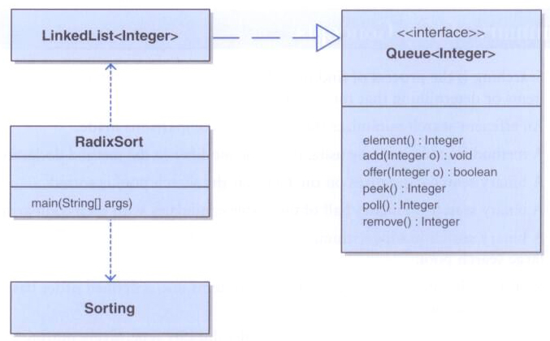
Radix Sort

Slide 47
Comparators
Instead of implementing Comparable, two objects can be compared using a Comparator object
A Comparator can be passed into a sorting method to determine the order of the sort
The Comparator interface has a single method, compare, that operates like the compareTo method of Comparable

Slide 48
Comparators
For example, suppose you wanted to sort Student objects in various ways
You could create a comparator that compares exam scores and another that compares assignment scores
Students are sorted based on which comparator you provide for the sort
The Student class doesn't have to commit to any particular comparison technique

Slide 49
import java.util.Comparator;
/**
* This Comparator sorts students by their exam average.
* @author Java Foundations
* @version 4.0
*/
public class ExamComparator implements Comparator<Student>
{
/**
* Compares two Student objects by their exam average.
*/
@Override
public int compare(Student o1, Student o2)
{
Integer average1 = o1.getExamAverage();
Integer average2 = o2.getExamAverage();
return average1.compareTo(average2);
}
}

Slide 50
import java.util.Comparator;
/**
* This Comparator sorts students by their assignment average.
* @author Java Foundations
* @version 4.0
*/
public class AssignmentComparator implements Comparator<Student>
{
/**
* Compares two Student objects by their assignment average.
*/
@Override
public int compare(Student o1, Student o2)
{
Integer average1 = o1.getAssignmentAverage();
Integer average2 = o2.getAssignmentAverage();
return average1.compareTo(average2);
}
}

Slide 51
import java.util.Arrays;
/**
* Demonstrates sorting using a Comparator.
* @author Java Foundations
* @version 4.0
*/
public class ComparatorDemo
{
/**
* Creates several Student objects, then sorts them using three
* different Comparator objects.
* @param args command-line arguments (unused)
*/
public static void main(String[] args)
{
Student[] students = new Student[5];
students[0] = new Student("Mary", 97, 75);
students[1] = new Student("James", 80, 80);
students[2] = new Student("Mark", 75, 94);
students[3] = new Student("Jolene", 95, 85);
students[4] = new Student("Cassandra", 85, 75);
// output students before sort
for (int i = 0; i < students.length; i++)
System.out.println(students[i]);

Slide 52
Arrays.sort(students, new ExamComparator());
// output students after sorting by exam average
System.out.println();
System.out.println("After sorting by exam average:");
for (int i = 0; i < students.length; i++)
System.out.println(students[i]);
Arrays.sort(students, new AssignmentComparator());
// output students after sorting by assignment average
System.out.println();
System.out.println("After sorting by assignment average:");
for (int i = 0; i < students.length; i++)
System.out.println(students[i]);
Arrays.sort(students, new OverallComparator());
// output students after sorting by overall average
System.out.println();
System.out.println("After sorting by overall average:");
for (int i = 0; i < students.length; i++)
System.out.println(students[i]);
}
}

